Slide 1
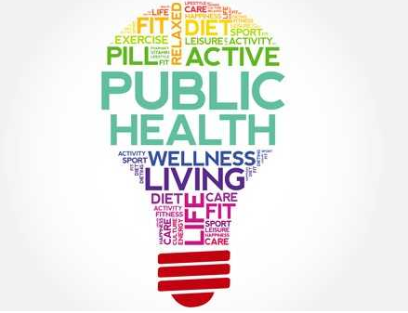
Data Analytics in Public Health
Live-tweet this event: @RLadiesPhilly, #RLadies
November 4, 2019 | Lightning Talks!
Notes:
Welcome!

Slide 2
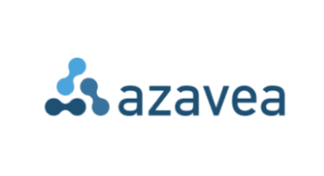
Thank you to our host and food sponsor!

Slide 3

R-Ladies Philly
Philadelphia chapter of R-Ladies Global
Gender diversity in the R community
Launched in January 2018
Volunteer-led
More than 700 members!
Notes:
We are the Philadelphia chapter of R-Ladies Global, a world-wide organization that promotes gender diversity in the R community and in data science more broadly. While our group name does have ‘R’ and ‘Ladies’ in the title, we welcome all individuals who share our values and follow our code of conduct and who have an interest in data science, regardless of proficiency with R.

Slide 4

R-Ladies Philly
Monthly meetups (free + 🍕🍕🍕)
Talks/hands-on workshops
Monthly code & coffees ☕
Quarterly happy hours
Real-world data science projects helping local nonprofits (e.g. PAWS)
Notes:
Meetups talks or workshops, Always free and there’s usually free pizza too
February + March Karla led a datathon which helped the Philadelphia Animal Welfare Society analyse their adoption data
Great opportunity for members to develop their skills and for us to provide useful insights for a local nonprofit
Collaborated with local data science groups such as Women in Kaggle Philly and Data Philly
Lots of events and opportunities
Networking

Slide 5
Get involved
Learn
Join our Meetup page and attend events
Follow us on Twitter @RLadiesPhilly
Contribute
Join our Slack channel
Introduce yourself on Slack (#welcome)
Write a blogpost
Ask questions
Organize
Lead a workshop
Give a talk
Ask your company to sponsor us 🍕
Be a co-organizer!
Notes:
Lots of opportunities to get involved
Attend!
Follow us on twitter
Chat with us on Slack
Share your skills with a workshop or talk
Help fund pizza or find location space
Or even, become a coorganizer

Slide 6
Announcements
November 7: Code & Coffee ☕
November 13: Comcast Networking & Recruitment Event
Enterprise Business Intelligence (EBI)
Data, analytics, data science, and engineering
Registration required
Contact Jessie Pluto (jessie_pluto@comcast.com)
Notes:
Jessie wil be at the code & coffee, good chance to talk with her about the Comcast event

Slide 7
Announcements
Rotating @WeAreRLadies twitter account
Objectives
To encourage and maintain Twitter engagement within the R-Ladies community.
To spotlight female and minority genders (including but not limited to cis/trans women, trans men, non-binary, genderqueer, agender) and their great work in R.
How It Works
Every week, a different R-Lady takes over our twitter account to talk about the work they do in R. Featured curators come from a diversity of professions and have a range of experiences in R, from novice to expert.
Notes:
Highlight a couple of opportunities to get involved

Slide 8





Connect with R-Ladies Philly
Twitter: @RLadiesPhilly
Blog: rladiesphilly.org
Meetup: meetup.com/rladies-philly
Slack: rladies-philly.slack.com
Email: philly@rladies.org

Slide 9
Speakers
Jenine K. Harris, PhD: I Can Code Clearly Now (10 tips for formatting your R code)
Jessica Streeter: Meeting People Where They Are: Data Science in a non-profit BH-MCO
Becca Nock, RN: So Much Health Care Data: Where does it come from? And what it is used for?
Marieke Jackson, MPH: Data Yenta: Data Science & Opioid Programming, A Love Story
Dr. Kristin Rising, MD MS: Using Data to Inform Delivery of Individualized Care
Notes:
Jenine Harris: R Ladies St. Louis leader, associate professor at washington u in st louis
Jessica Streeter: medical sociologist turned data scientist at SpringHealth in NYC; working with issues around mental health for over a decade including everything from direct care to academia to managed care, to mental health tech startups.
Becca Nock: registered nurse and the Manager of Analytics at HealthVerity
Marieke Jackson: Data scientist with Code for Philly, and is leading an initiative with other data groups in the city including R Ladies Philly to fight the opioid epidemic
Dr. Rising is an emergency medicine physician and associate processor and director of acute care transitions at Thomas Jefferson University Hospital. She also has a powerful research profile with interests in health services research, population health, transitions of care, innovations in health care delivery and patient engagement.

Slide 10
I Can Code Clearly Now
10 tips for formatting your R code
Jenine Harris, PhD | Co-Founder & Organizer, R-Ladies St. Louis

Slide 11
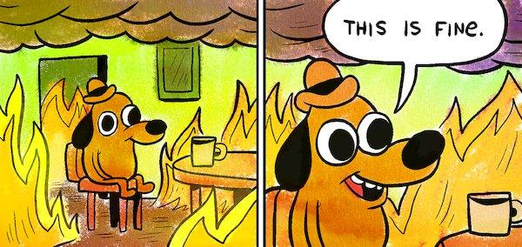
The problem with research quality
500-600 scientific papers are retracted every year (this # is rising!)
In a 10-year period, over 400,000 subjects were enrolled and 70,501 subjects were treated in studies later retracted
Researchers replicating studies were successful for 21% of 67 drug studies, 40% to 60% of psychology studies, and 61% of economics studies
Notes:
Poor quality research may have serious consequences for human health.
Retraction Watch reports 500–600 scientific papers are retracted each year, and this number appears to be rising. Retracted papers continue to be cited frequently after retraction, presumably often in support of related research and more than 70,000 subjects have been treated in studies later retracted.
This is not fine.
NEJM study cited 371 times AFTER retraction (1600+ times before)

Slide 12

Why is it so hard to replicate or reproduce studies?
Errors and omissions are a big part of the problem
6% of p-values were reported incorrectly in psychology papers
11% of p-values were incorrectly reported in medical papers
20% to 80% of papers in top journals omitted or were unclear about sample size
Up to 40% of papers in top journals did not include the type of statistical tests performed
Tables were mislabeled in 3 of 6 public health studies
Notes:
Error and omission are responsible for 73.5% of retractions, while fraud is implicated in 26.5%
Some examples of the types of errors that challenge researchers are the mis-reporting of p-values, which happened in 6% of papers in a sample from psychology journals and 11% in a sample of medical papers.
Twenty to eighty percent of studies published in ten top scientific journals omitted or were unclear about sample sizes and up to 40% of papers in these journals did not include the type of statistical tests performed
A study of six public health papers found tables were mislabeled in three of the papers

Slide 13
What can we do?
Improve research quality through the use of reproducible research practices
For a scientist, adopting reproducible research practices results in publications with fewer errors that are cited more
For society, use of reproducible research practices by scientists:
Speeds up scientific discovery
Fosters greater exchange of ideas among scientists
Reduces research waste
Notes:
The gold standard for confirming results and reducing error, omission, and fraud is replication, or conducting an entire study a second time to verify its results [13].
Because replication is not always feasible due to cost, reproducing a study, or analyzing an existing data source to produce the same study results, has been proposed as a minimum standard increasing the reliability of reported research findings.
Adopting reproducible research practices speeds up scientific discovery, fosters greater exchange of ideas among scientists, and reduces research waste [16,17]. In addition to these societal benefits, research papers with shared data have fewer errors, those with shared data or shared code are cited more, and shared data sources are the basis for more publications [17,18].

Slide 14
What is reproducibility?
Reproducibility is distinct from repeatability and replicability
same data + same code
this study is repeatable
same data + same or new code = same results
this study is reproducible
new data + new code = same results
this study is replicable
Research is reproducible when data are accessible and data management and analysis instructions are clear and complete
Notes:
The vocabulary around repeating a study, research replication, and research reproducibility is still evolving in the research community and is not always used consistently, but there seems to be some agreement developing around the distinctions shown on the slide:
Repeating is doing the same thing again using the same data and statistical code
Reproducibility is repeating the study and getting the same results
Replication is collecting new data and analyzing it to get the same results
Essentially research is reproducible when data are accessible and data management and analysis instructions are clear and complete.

Slide 15
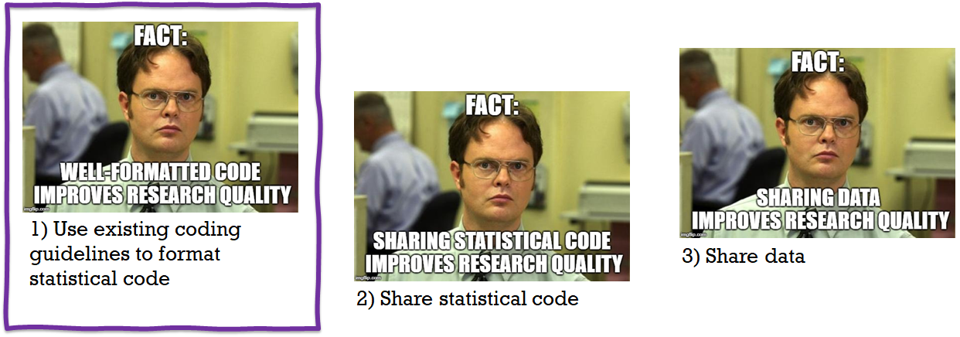
Three changes we can make to improve research reproducibility
Notes:
In order to meet the two requirements for reproducible research: accessible data and clear instructions for data management and analysis, there are three steps researchers can take:
(1)Use existing guidelines to format statistical code. These are available for most statistical programs including SAS and R.
(2)Share well-formatted statistical code, and
(3)Share data
●
A good place to start is with well-formatted code. The next set of slides gives 10 tips for clearly formatting code as one way to improve reproducibility.

Slide 16
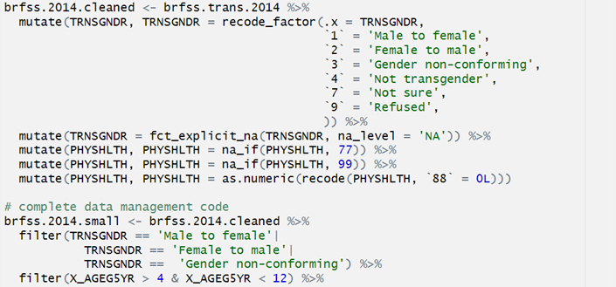
Code Formatting Top 10
Limit line length to 80 characters
(3) Indent to group lines of code that belong together
(2) Use white space to separate processes
4) Add spaces around operators (=, +, -, <-, etc.) and after commas

Slide 17
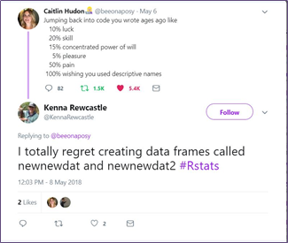
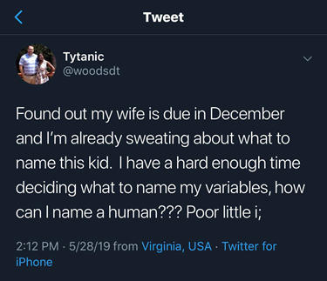
Code Formatting Top 10
(6) Use dot.case, camelCase, or PascalCase for multi-part names
In R:
camelCase for data frame and variable names (dot.case used to be recommended)
kCamelCase for constants
UpperCamelCase for functions (a.k.a. PascalCase)
(5) Use meaningful names for objects
(7) Include meta-data like the date and project name in file names
Key principles:
Machine readable
Works with default ordering
Human readable
Example:
180228_raw_postProgram.csv

Slide 18
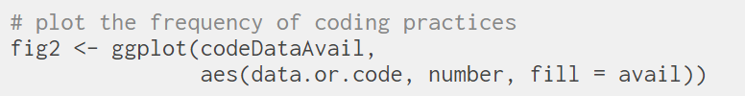
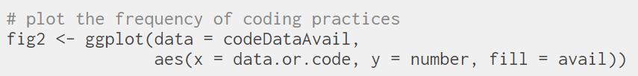
Code Formatting Top 10
(8) Use comments strategically (to explain analytic choices rather than to make up for sloppy code)
(9) Use function arguments

Slide 19
Code Formatting Top 10
(10) Introduce your code with a prolog
# PROLOG ################################################################
# PROJECT: NAME OF PROJECT HERE
# PURPOSE: MAJOR POINT(S) OF WHAT I AM DOING WITH THE DATA HERE
# DIR: list directory(-ies) for files here
# DATA: list dataset file names/availability here, e.g.,
# filename.correctextention
# somewebaddress.com
# AUTHOR: AUTHOR NAME(S)
# CREATED: MONTH dd, YEAR
# LATEST: MONTH dd, YEAR
# NOTES: indent all additional lines under each heading,
# & use the apostrophe hashmark bookends that appear
# KEEP PURPOSE, AUTHOR, CREATED & LATEST ENTRIES IN UPPER CASE,
# with appropriate case for DIR & DATA, lower case for notes
# If multiple lines become too much,
# simplify and write code book and readme.
# PROLOG ###############################################################

Slide 20

Top 10 Code Formatting Recommendations
1.Limit line length to 80 characters
2.Use white space to separate processes
3.Indent to group lines of code that belong together
4.Add spaces around operators (=, +, -, <-, etc.) and after commas
5.Use meaningful names for objects
6.Use dot.case, camelCase, or PascalCase for multi-part names
7.Include meta-data like the date and project name in file names
8.Use comments strategically
9.Use function arguments
10.Include a prolog to introduce the code
spacing
naming
explaining

Slide 21
Resources
R style guides
https://google.github.io/styleguide/Rguide.html
https://style.tidyverse.org/
Open access articles:
Use of reproducible research practices in public health: A survey of public health analysts (Plos One)
Three Changes Public Health Scientists Can Make to Help Build a Culture of Reproducible Research (Public Health Reports)
Web-based toolkit on formatting and sharing code, data, and other research documentation:
https://coding2share.github.io/ReproducibilityToolkit/

Slide 22
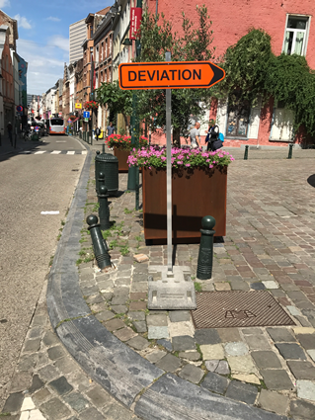
Thank you!
If you want to connect with me to talk about R, R-Ladies, useR!2020, reproducibility, tennis, women in data science, Pokémon Go, Star Trek, whiskey cocktails, or yoga, try:
@jenineharris (Twitter)
harrisj@wustl.edu (email)
9205 2033 3717 (PoGo friend code, I’m Statsgrl)

Slide 23
Meeting People Where They Are
Data Science in a Non-Profit BH-MCO
Jessica Streeter | @phillynerd | phillynerd.netlify.com

Slide 24
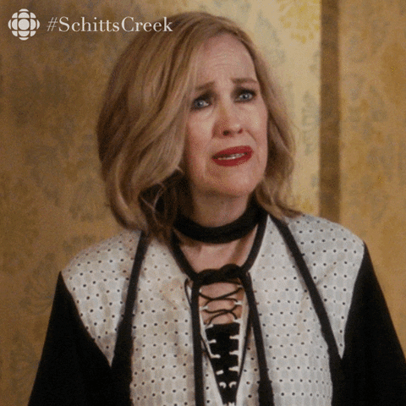
Data + Mental Health =

Slide 25

Data
+ Mental Health
+ Phenomenal but not Data-Savvy Clinicians
+ Really Dated Tech =

Slide 26
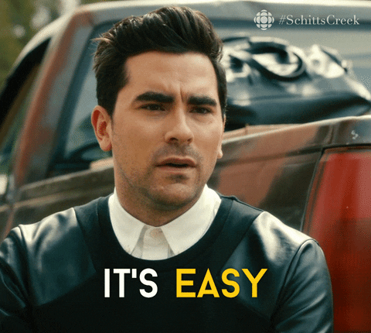
So what can we do?
Meet people where they are
Put in the work up front
Be a strong translator
Be flexible on tools and methods

Slide 27
Case Study
At Community Behavioral Health
Initial Goal: Create different cohorts for kids based on risk.
Oh, we already defined this risk and the groups aren’t mutually exclusive, and the groups won’t necessarily get different treatments
Revised Goal: Find whose low risk so we can spend less time on those groups
Final Product….

Slide 28
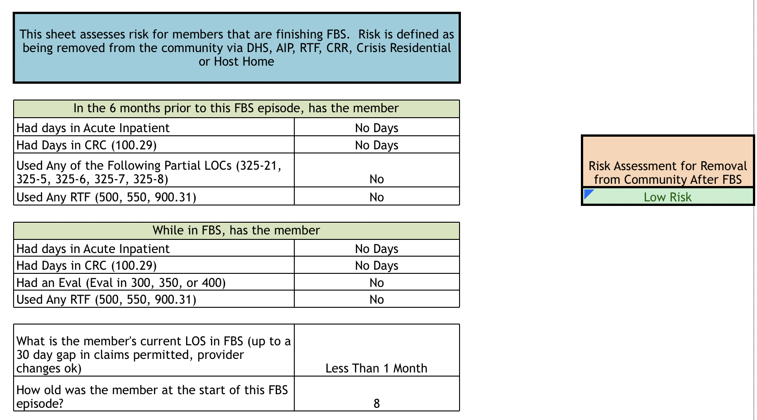

AN EXCEL CALCULATOR

Slide 29
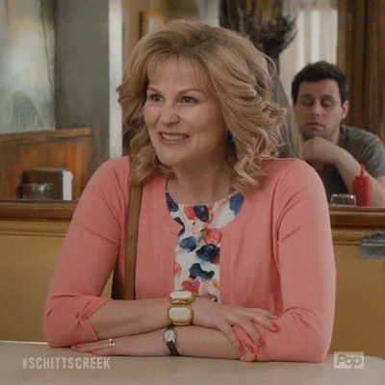
Wait, what now?
Lots of fancy r code in the background (random forest for feature importance, then final modeling is a logistic regression)
Chose a model that wasn’t a black box
Could make it manual bc of long LOS and limited cohort size
Excel is familiar with low tech burden

Slide 30

Outcomes
All Clinicians were very open to using the calculator
Low burden, could integrate into their normal routine easily
Clinician facing calculator was in terms they understood
All the math was hidden
Assessing the model’s performance is fairly straightforward because of R backend
Model performed extremely well over next 2 years

Slide 31

Final points
Meet people where they are
Put in the work up front
Be a strong translator
Be flexible on tools and methods
Oh, and CBH is hiring!

Slide 32
So Much Health Care Data!
Where does it come from? And what is it used for?
Becca Nock, RN | Manager, Data Analytics at HealthVerity

Slide 33

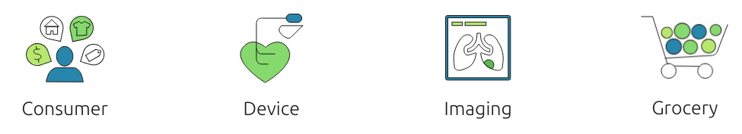
Where does it come from?
https://healthverity.com/solutions/healthverity-marketplace/

Slide 34

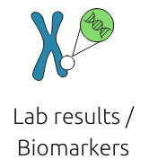


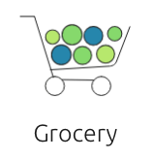
One Doctor’s Visit: An Example
https://healthverity.com/solutions/healthverity-marketplace/
Notes:
Using diabetes as an example

Slide 35
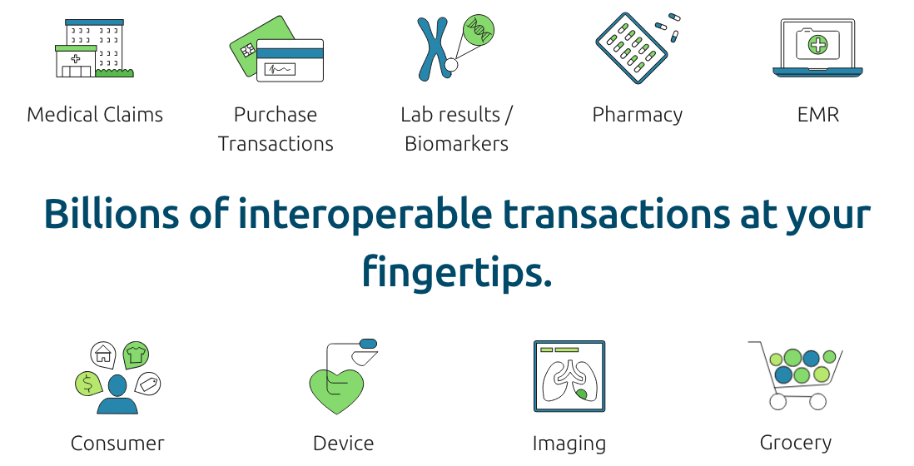
Interoperability
https://healthverity.com/solutions/healthverity-marketplace/

Slide 36


Structured & Unstructured Data
versus
https://healthverity.com/solutions/healthverity-marketplace/

Slide 37
Use Cases
Identifying patients with rare diseases
Determining clinical trial sites
Seeing what medications a patient takes after leaving the hospital
Following the uptake of new products that have entered the market
Understanding how providers are prescribing or administering a drug

Slide 38
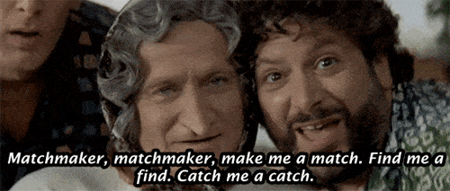
Data Yenta:
Data Science & Opioid Programming, A Love Story
Marieke Jackson, MPH | Code for Philly

Slide 39
How do we solve a problem?
Public Health Practitioner :
How can we pay for this?
What does the $$ stipulate?
Data Nerd :
What is the breadth of the problem?
What do we know?
What can’t we know?
What can we find out?

Slide 40
Prevention Point
Serves tens of thousands of individuals annually
Tracks participant data in Excel, partner systems, & paper forms
Code for Philly building EHR
How will this change organizational attitudes towards data?

Slide 41
The Recipe for Success
Quality Data
Civic Tech
Non-profit organizations
Unanswered questions
Data Scientists
Public Health Practitioners
Developers
Government agencies

Slide 42
Defining “Unanswered Questions”
Applicable to multiple organizations
Broad enough for multiple methods of analysis
Examples:
How many IV drug users are in Philadelphia?
What are the measurable effects of the Naloxone program?
What are the geographic traits of the opioid problem?

Slide 43
2020 Opioid Data Hackathon
February - April 2020
Code for Philly, R Ladies Philly, Data Philly, & Data Jawn
Community Partners present at kickoff meeting
Analysis built to answer questions posed by community partners

Slide 44
Using Data to Inform Delivery of Individualized Care
Kristin Rising, MD MS
Associate Professor and Director of Acute Care Transitions
Department of Emergency Medicine
Thomas Jefferson University
Notes:
Quick tour of my path towards focusing on:
patient uncertainty
Food is medicine

Slide 45
Theme: Developing patient-centered interventions in response to patient-identified needs
Model of Uncertainty and Care Seeking
Food is Medicine for Patients with Diabetes
Notes:
Turning qualitative into interventional studies

Slide 46
Patient Perspective: ED Returns
Inpatient admission
WHY?
FEAR AND UNCERTAINTY
related to symptoms
Inpatient discharge
Stay home
ED Visit
ED discharge
Stay home
Rising et al. Ann Emer Med. 2015;65(4):377-386.
Notes:
Lots of focus on recurrent hospitalization and ED visits – efforts to reduce them – NOT WORKING

Slide 47
Fear and Uncertainty
“I just don’t know where the deterioration’s coming from, and I’m so afraid, and that’s been creating a lot of anxiety for me.”
“… but where is this pain coming from? I just hope they can find out today why I keep having this pain.”
Notes:
End of fellowship
Uncertainty - Nebulous topic – what do I do about it???

Slide 48
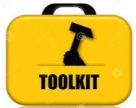
Patient Needs at ED discharge
Primary expectations: diagnosis and reassurance
Primary needs at discharge: answers
🡪 Cause of symptoms
🡪 What to expect
Rising et al. Ann Emer Med. 2016;68(5):536-543.
Notes:
Started on faculty – new line of work – how can we develop a more individualized approach to ED discharge
Goal – build a discharge toolkit with which can individualize the discharge
Anticipated patient – wide range of needs

Slide 49
“Because if I don’t find out what it is, I’m gonna still come. I’m gonna come back. You gonna tell me something. I keep coming back until you find something out.”

Slide 50
Patient needs at ED discharge
Rising et al. Ann Emer Med. 2016;68(5):536-543.
Notes:
Idea of a toolkit fell apart – pushed me back to focusing on uncertainty

Slide 51
Patients are uncertain
Uncertainty is often distressing
Patients seek care to reduce uncertainty
Notes:
UNCERTAINTY IS NOT NEW - Step back and look to the literature

Slide 52
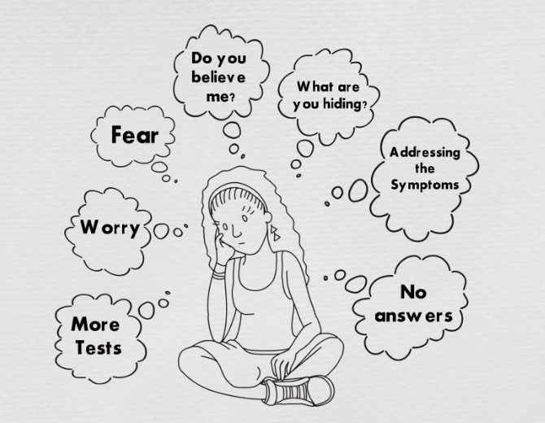
Notes:
Uncertainty is distressing to patients

Slide 53
Functional needs related to seeking diagnosis
Reassurance
Treatment/guidance for symptoms
Clear communication about testing, treatment, and diagnosis
Explanation for symptoms
Gerolamo et al. Ann Emer Med. 2018;72(30):282-288.
Notes:
Most patients identified diagnosis as primary need – what does this mean???
We often can’t provide a diagnosis – but what else can we give them to help manage uncertainty?

Slide 54
(Wanted to hear): “We checked you out. I heard your symptoms. This isn’t common, but it’s not unheard of… You can have a bronchospasm, be a healthy person. You coughed up a little blood or you burst a blood vessel or something like that.”
“I needed to know, for what time frame it would be preventing me from going through my day-to-day normal life routine.”
”All they had to do was tell me we’re not sure what’s wrong, and the next step would be probably imaging, but we can’t do your imaging because A, B, C, and D. And I would have said okay.”
Notes:
Want to be heard
Need to future plan
Want clear communication about lack of diagnosis / next steps

Slide 55
Current Uncertainty Projects
*Quantify and address patient uncertainty
Uncertainty-Scale (U-Scale)
Uncertainty Communication Checklist / Curriculum

Slide 56
Model of Uncertainty and Care Seeking
Food is Medicine for Patients with Diabetes
Notes:
Turning qualitative into interventional studies

Slide 57
Food is Medicine
PCORI study
Test methods of patient engagement
Population: patients with poorly controlled diabetes
Needs associated with seeking care
🡪 access to food & nutrition education

Slide 58
Food is Medicine
NIH-funded study
$3.2 million, RCT with 600 patients
Test:
Medically tailored meals (MTM) – MANNA
MTM + telehealth-delivered medical nutrition therapy
Outcomes: hemoglobin A1c, cost effectiveness
Goal: Inform policy change to cover these interventions as routine benefits

Slide 59
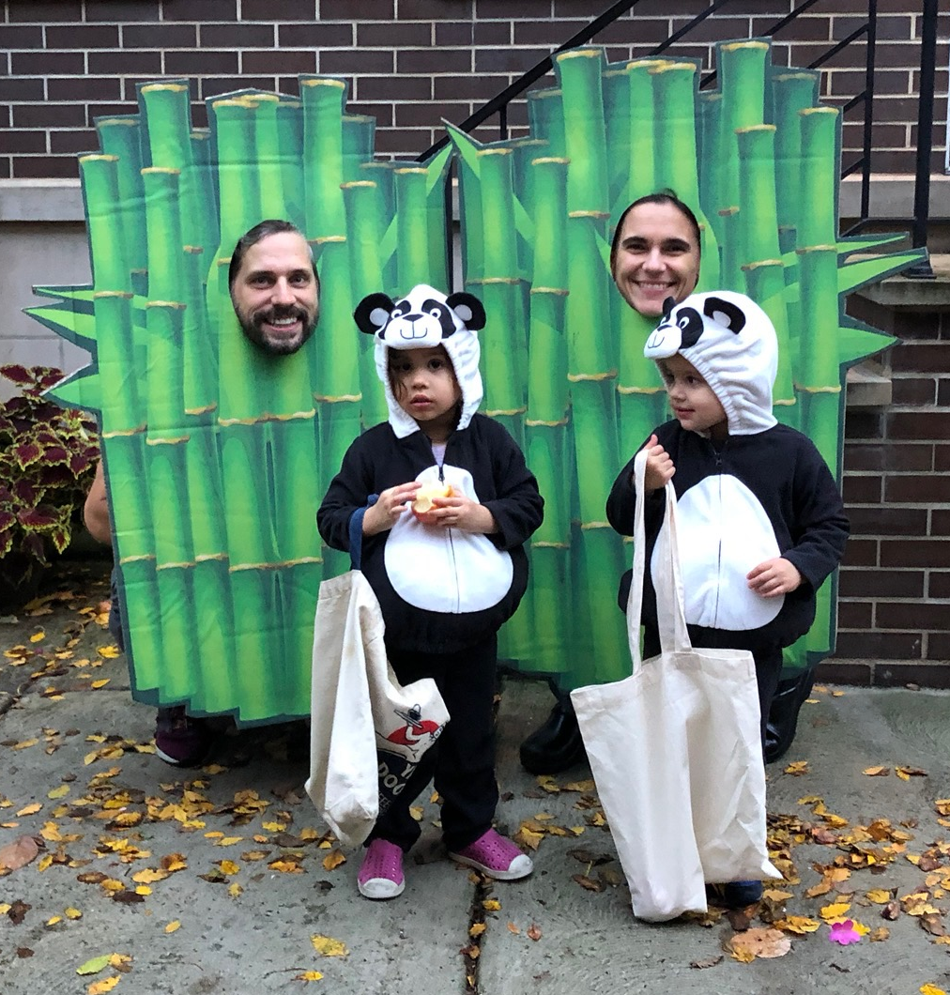
Kristin.rising@Jefferson.edu
@RisingKristin

